Slide 1

Title: Personalised Career Roadmap builder
Student Name: Manaswi chilukuri Student ID: 2520030411 Cluster:2
Section: 5
Under the Guidance of
Supervisor Name: xxxxxxxx Assistant Professor Department of CSE
04-03-2026
1

Slide 2
OUTLINE
1.
2.
3.
4.
5.
6.
7.
Abstract Existing System
Proposed System System Architecture Project Modules Objectives
Co’s Attainments - FWD
1.
2.
Co1
Co2 …….. 5. Co5
8.
Co’s Attainments - DSA
1.
2.
Co1
Co2 …….. 5. Co5
9.
10.
11.
Screen Shots for FWD & DSA Conclusion
Geo-Tagged Photos
Department of CSE

Slide 3
Abstract
The Personalized Career Roadmap Builder is a web-based application developed to help students plan their career paths in a structured and organized manner.
Many students face confusion while choosing a career due to lack of proper guidance and clear information about required skills and learning paths.
This project aims to provide a platform where users can enter their interests, preferred career field, or career goals.
Based on the user input, the system generates a personalised roadmap that outlines the necessary skills, learning steps, and milestones required to achieve the desired career.
The roadmap helps students understand the sequence of learning and the important stages involved in reaching their professional goals.
The project demonstrates how web technologies can be used to create practical tools that assist students in making informed career decisions.
Overall, the system helps users gain clarity, set achievable goals, and follow a structured path toward their chosen career.
Department of CSE

Slide 4
Existing System
Students usually rely on general career advice from websites or blogs.
Career guidance is often taken from teachers, friends, or family members.
Most platforms provide generic career information, not personalized guidance.
Students have to search different websites to find required skills, courses, and career paths.
There is no structured roadmap that clearly shows the step-by-step path to achieve a specific career.
Due to this, students often feel confused and lack proper direction while planning their careers.
Department of CSE

Slide 5
Proposed System
The proposed system is a web-based application that helps students create a personalized career roadmap based on their interests and career goals.
Users can enter their preferred career field or interests, and the system generates a step-by-step roadmap showing the skills and learning stages required.
The platform provides structured guidance, helping students understand what they need to learn and in what order.
It reduces confusion by presenting clear milestones such as learning skills, building projects, and gaining experience.
The system offers a simple and user-friendly interface, making it easy for students to explore different career paths.
By using technology to organize career information, the proposed system helps students plan their future more effectively and make inform
Department of CSE

Slide 6
System Architecture
User Interface (Frontend)
The user interacts with the website by entering their career interests or goals.
Input Processing
The system processes the user input to understand the selected career path.
Career Database / Data Mapping
The system checks stored information about different careers and their required skills.
Roadmap Generation Module
Based on the selected career, the system generates a step-by-step roadmap including skills, learning stages, and milestones.
Output Display
The generated roadmap is displayed on the website for the user to view.
Department of CSE

Slide 7
Project Modules
User Input Module
This module allows users to enter their career interests, skills, or preferred career field.
It collects the required information from the user through a simple form interface.
Career Data Module
This module stores information about different career paths and the skills required for each career.
It acts as a reference database for generating career roadmaps.
Roadmap Generation Module
This module processes the user input and matches it with the stored career data.
It generates a step-by-step career roadmap including skills, learning stages, and milestones.
Output Display Module
This module displays the generated career roadmap to the user in a clear and structured format.
Users can easily understand the steps required to achieve their career goals.
User Interface Module
This module provides a simple and interactive website interface.
It ensures that users can easily navigate and interact with the system.
Department of CSE

Slide 8
Objectives
To develop a web-based platform that helps students plan their career paths effectively.
To provide a personalized career roadmap based on the user’s interests and career goals.
To help students understand the skills and learning steps required for different career options.
To reduce confusion in career planning by providing clear and structured guidance.
To create a simple and user-friendly interface that allows users to easily explore career paths.
To demonstrate how web technologies can be used to build useful tools for students.
Department of CSE

Slide 9
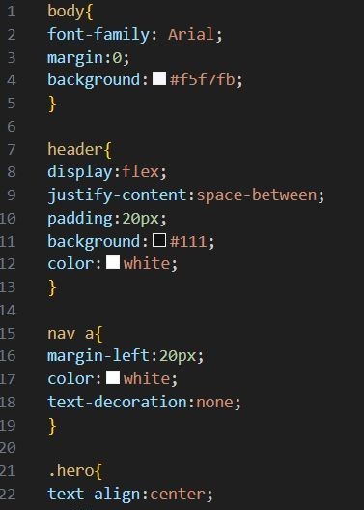
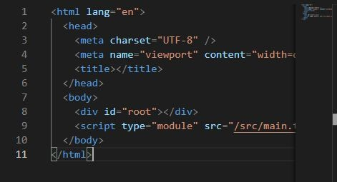
Co’s Attainments - FWD
1. co-1 - Internal Fundamentals ,
2. HTML Structure and basic CSS
2.CO-2 -Forms,semantic experience and advanced CSS layout
Department of CS
E

Slide 10
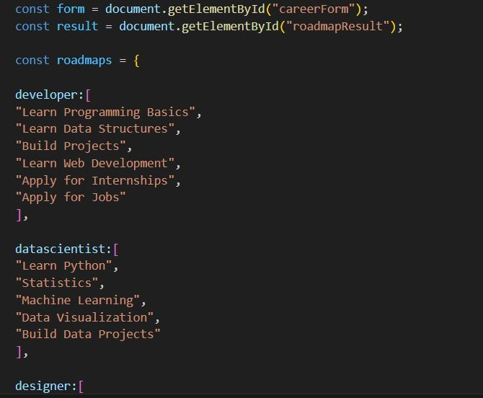
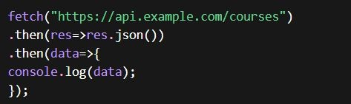
4.CO-4 DOM manipulation,Events and
3. CO-3 -java script programing fundamentals
CO- 5 Advanced Web Development Github Version Controls & Deployment

Slide 11
Conclusion
The Personalized Career Roadmap Generator helps users explore career paths and understand the steps required to achieve their goals. By allowing users to input their desired career, the system generates a structured roadmap that outlines key skills, learning stages, and actions needed to progress in that field.
Additional features such as the career quiz, progress tracker, and interactive interface make the platform more engaging and useful for students who are unsure about their future career direction.
Overall, this project demonstrates how web technologies like HTML, CSS, and JavaScript can be used to create an interactive tool that supports career planning and skill development. In the future, the system can be expanded with more career options, AI-based recommendations, and integration with learning platforms to provide even more personalized guidance.
Department of CSE

Slide 12
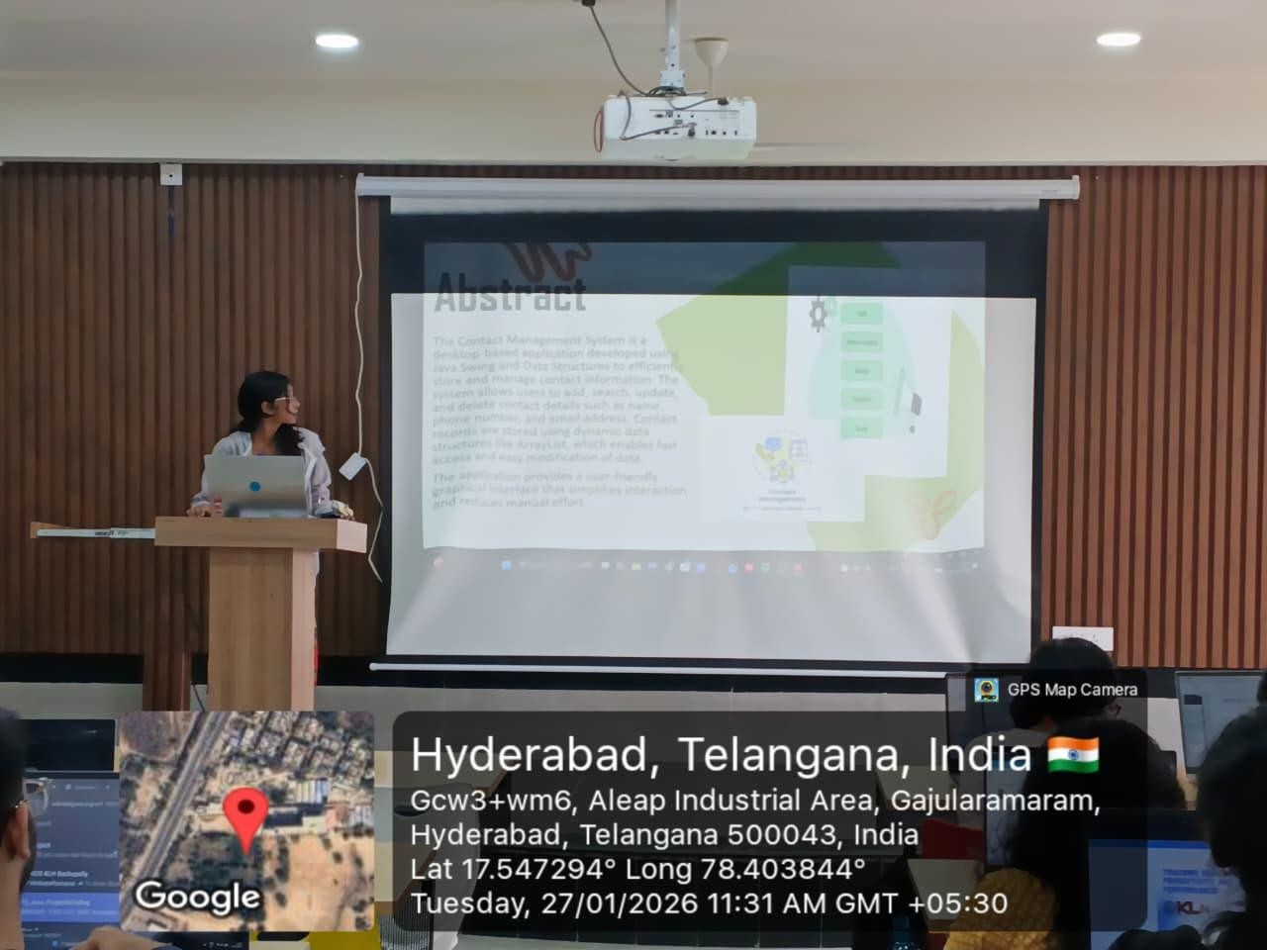
Geo- Tag Photos
Department of CSE

Slide 13
THANK YOU
Department of CSE

